Slide 1
Vscode plugin
Emails that don’t offend investors

Slide 2
Lab preparation – Homework
Congratulations, you are a startup owner of a future billion dollar company. You suspect your eccentric angel investor hates special characters in e-mail addresses due to the fact his previous girlfriend’s name was improbably “That *!&#$%^”. You want to make sure that no e-mail ever contains these particular characters.
Design a BNF for an e-mail address with the following rules for your domain:
- It is of the form <local-part>@torpedodepot.<domain-suffix>
- <local-part> is ONLY alpha-numeric characters.
- <domain-suffix> can only be .net, .com, or .wannabemil
- Use ANTLR .g4 format in your design. What is this you ask? Read on.
- Draw a finite state machine for the tokenizer used in your rules (lexical analyzer, lexer).

Slide 3
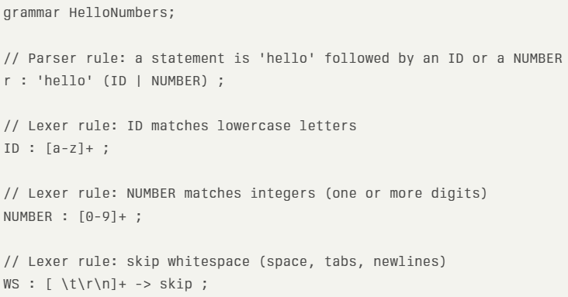
ANTLR - ANother Tool for Language Recognition
Takes as input a grammar that specifies a language and generates as output source code for a recognizer of that language. Very common.
Example grammar:

Slide 4
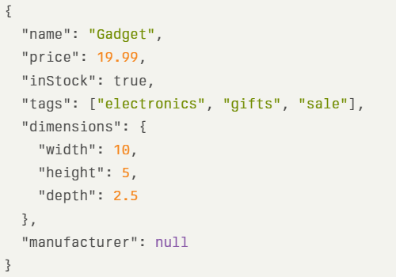
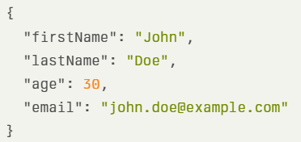
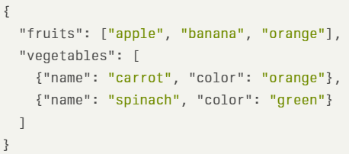
Tools introduction
JSON - (JavaScript Object Notation) is a lightweight, text-based format used for storing and exchanging structured data. It is human-readable and language-independent, consisting of name/value pairs and arrays, making it easy to transmit data between systems like web servers and clients.

Slide 5
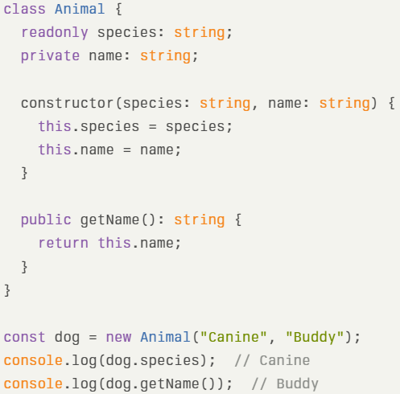
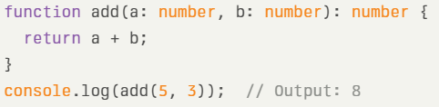
typescript
TypeScript is a high-level programming language that is a statically typed superset of JavaScript. (static typing means the data type is known at compile time, we will learn more about it as the class goes on)
TypeScript is rapidly becoming blazingly popular. More popular than K-Pop Demon Hunters probably.

Slide 6
Lab
You have made a policy at your company that everyone must use VSCode for everything, including word processing. It is just easier that way. We need to make sure that emails do not offend our investors.

Slide 7
Lab
Make a VSCode plugin.
  The plugin will use ANTLR
  It will highlight emails blue. Emails are specified by your grammar.
    valid@torpedodepot.com - should be blue
    test123@torpedodepot.net - should be blue
    user@torpedodepot.wannabemil - should be blue
    invalid@gmail.com - should NOT be highlighted
    user@yahoo.net - should NOT be highlighted
    notanemail - should NOT be highlighted
  There are shortcut methods that use regular expressions. Don’t use the shortcuts. Make sure you are using the grammar. (i.e. you are using a .g4 file)
- Vibe coding is encouraged. This is a large project to do in a small amount of time.

Slide 8
deliverables
Send an email to richard.Thompson@nps.edu that includes:
* Screenshot of text that includes valid and invalid emails, highlighted in blue.
* Your plugin code (.ts file and .g4 file).
Format of email is less important than content.

